Slide 1
Case2: Fabric & craft store
Yu-Min Wang
Fall 2017
MKT 6v99

Slide 2
Seven Segments
Dabbler
They consist of the most customers(23%) but consume the least sales(5%). They spend $0 on 9 categories but the share on other is the highest(25%).
Paper Lover
The 2nd highest % in customers(21%) but the 3rd lowest % in sales(8%). The highest share in paper(12%), also highest share in pct, impulse, kids, jewelry, paint, celeb, fleece, and bccomp. The lowest share in sew.
Needle Lover
13% of customers contributing 11% of sales. They spend $0 on 2 categories. The highest share in needle(19%) and in public(3%).
Home Decorator
12% of customers contributing only 5% sales(the lowest). They spend $0 in 5 categories. Highest share in homedec(25%), foam(10%), and warm(6%).
Crafter
12% of customers contributing 22% of sales(2nd highest). They spend in every category. The highest share in ribbon(3%). The 2nd highest share in paper, pct, impulse, kids, paint, celeb, and bccomp.
Sewer & Quilter
12% of customers contributing 17% of sales. They spend $0 on 2 categories. Spend the highest share in sew(18%), quilt(18%), and fabric(8%)
Premier
They consist of the least customers(7%) but consume the most sales(32%). They spend money on every category, but no highest share in some category. They spend the 2nd highest share in quilt and public.

Slide 3
% Customers v. % Revenue

Slide 4
Top down kpi
 | Dabbler | Paper Lover | Needle Lover | Home Decorator | Crafter | Sewer & Quilter | Premier
% Customers | 23% | 21% | 13% | 12% | 12% | 12% | 7%
% Revenue | 5% | 8% | 11% | 5% | 22% | 17% | 32%
share sew | 17% | 5% | 10% | 15% | 9% | 18% | 13%
share paper | 0% | 12% | 2% | 0% | 9% | 0% | 2%
share pct | 2% | 4% | 1% | 0% | 4% | 1% | 1%
share needle | 14% | 5% | 19% | 2% | 4% | 5% | 7%
share quilt | 10% | 0% | 7% | 12% | 7% | 18% | 13%
share impulse | 2% | 3% | 3% | 2% | 3% | 2% | 2%
share other | 28% | 26% | 20% | 15% | 23% | 15% | 19%
share kids | 0% | 5% | 3% | 1% | 4% | 1% | 2%
share jewelry | 5% | 6% | 3% | 3% | 4% | 1% | 2%
share ribbon | 2% | 3% | 2% | 0% | 3% | 1% | 2%
share paint | 0% | 7% | 4% | 1% | 5% | 0% | 2%
share seasfloral | 4% | 4% | 2% | 1% | 2% | 1% | 1%
share celeb | 0% | 5% | 2% | 0% | 4% | 1% | 2%
share fabric | 7% | 0% | 2% | 4% | 3% | 8% | 7%
share fleece | 0% | 8% | 0% | 4% | 3% | 6% | 5%
share warm | 0% | 0% | 0% | 6% | 2% | 5% | 4%
share homedec | 0% | 0% | 6% | 25% | 3% | 5% | 4%
share public | 0% | 1% | 3% | 1% | 1% | 1% | 3%
share special | 5% | 0% | 3% | 0% | 1% | 4% | 3%
share foam | 0% | 0% | 3% | 10% | 2% | 6% | 4%
share bccomp | 2% | 4% | 3% | 1% | 4% | 1% | 2%
# of $0 category | 9 | 6 | 2 | 5 | 0 | 2 | 0
% sms_cnt | 19% | 22% | 14% | 12% | 12% | 12% | 8%
% email_cnt | 18% | 19% | 13% | 10% | 16% | 13% | 9%
% mail_cnt | 12% | 13% | 15% | 7% | 21% | 17% | 16%

Slide 5
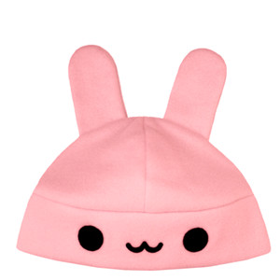
Segment strategy 1 - Dabbler
Least Profitable Segment
23% of customers with 5% of revenue
Spend zero on 9 product categories
Highest spend share in Other (28%)
Suggested product target - Other
Inelastic
Increase net price by 50% ➔ Revenue will increase by $9,538
Suggested vehicle - SMS
Increase 8 SMS for each customer ➔ Revenue will increase by $1,347
Total revenue increase = $10,885 (13%)

Slide 6

Segment strategy 2 – paper lover
Less Contribution Segment
21% of customers with 8% of revenue
Spend zero on 6 product categories
Highest spend share in Paper (12%)
Suggested product target - Paper
Inelastic
Increase net price by 50% ➔ Revenue will increase by $5,352
Suggested vehicle - Mail
Increase 10 Mail for each customer ➔ Revenue will increase by $7,990
Total revenue increase = $13,342 (16%)

Slide 7

Segment strategy 3 – needle lover
Average Contribution Segment
13% of customers with 11% of revenue
Spend zero on 2 product categories
Highest spend share in Needle (19%)
Suggested product target - Needle
Inelastic
Increase net price by 50% ➔ Revenue will increase by $13,387
Suggested vehicle – Email & Mail
Increase 20 Email for each customer ➔ Revenue will increase by $1,109
Increase 10 Mail for each customer ➔ Revenue will increase by $15,536
Total revenue increase = $30,032 (16%)

Slide 8

Segment strategy 4 – Home decorator
Least Profitable Segment
12% of customers with 5% of revenue
Spend zero on 5 product categories
Highest spend share in Homedec (25%)
Suggested product target - Homedec
Inelastic
Increase net price by 50% ➔ Revenue will increase by $8,009
Suggested vehicle – SMS
Increase 10 SMS for each customer ➔ Revenue will increase by $1,739
Total revenue increase = $9,748 (11%)

Slide 9
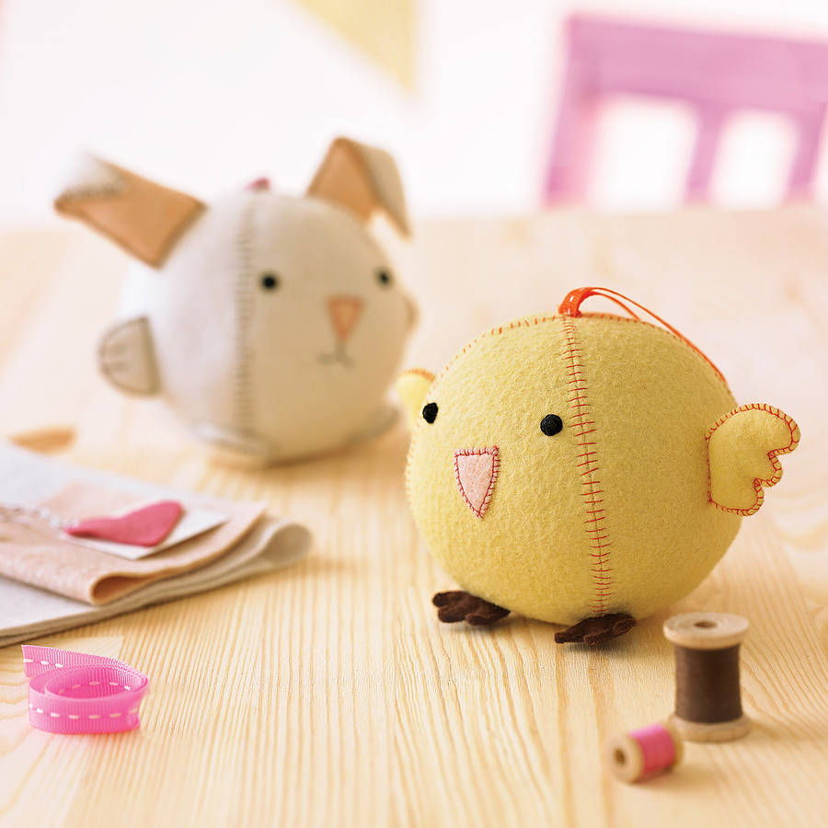
Segment strategy 5 – Crafter
Good Contribution Segment
12% of customers with 22% of revenue
Spend on every product categories
Spend share in ribbon (3%) and other (23%)
Suggested product target - Other
Inelastic
Increase net price by 50% ➔ Revenue will increase by $30,324
Suggested vehicle – Mail
Increase 10 Mail for each customer ➔ Revenue will increase by $8,540
Total revenue increase = $38,863 (11%)

Slide 10
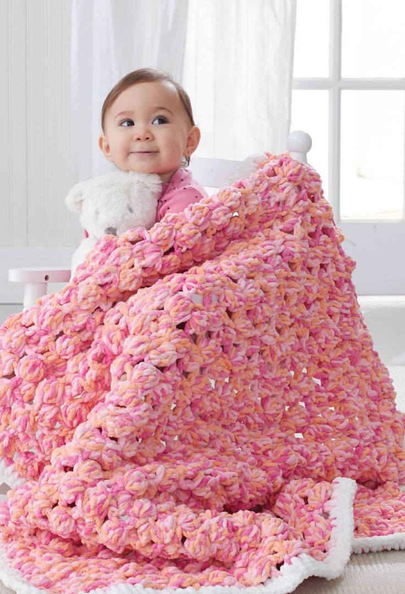
Segment strategy 6 – Sewer & Quilter
Average Contribution Segment
12% of customers with 17% of revenue
Spend zero 2 product categories
Highest spend share in sew (18%) and quilt (18%)
Suggested product target - Sew
Inelastic
Increase net price by 50% ➔ Revenue will increase by $21,146
Suggested vehicle – Mail
Increase 15 Mail for each customer ➔ Revenue will increase by $10,288
Total revenue increase = $31,433 (11%)

Slide 11
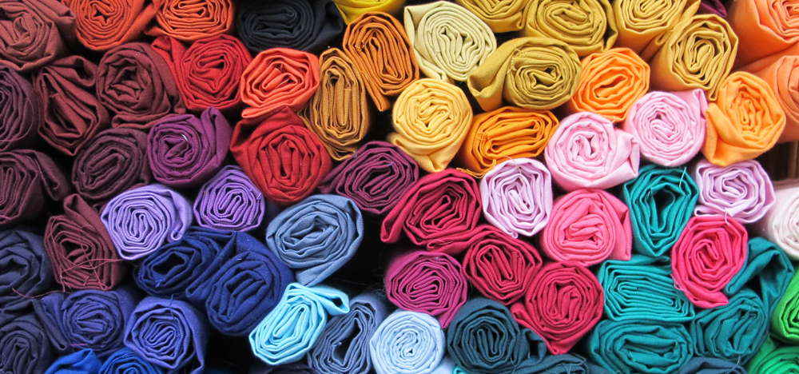
Segment strategy 7 – Premier
Best Contribution Segment
7% of customers with 32% of revenue
Spend money on every product category
No highest spend share in each category
Suggested product target - Quilt
Inelastic
Increase net price by 50% ➔ Revenue will increase by $15,204
Suggested vehicle – Mail
Increase 20 Mail for each customer ➔ Revenue will increase by $4,724
Total revenue increase = $19,928 (4%)

Slide 12

Test plan
Dabbler | ‘Other’ net price up 10% (90 days) ➔ 30% (90 days) ➔ 50%. SMS up 8 in 180 days
Paper Lover | ‘Paper’ net price up 10% (90 days) ➔ 30% (90 days) ➔ 50%. Mail up 10 in 180 days
Needle Lover | ‘Needle’ net price up 10% (90 days) ➔ 30% (90 days) ➔ 50%. Email up 20 in 180 days, Mail up 10 in 180 days
Home Decorator | ‘Homedec’ net price up 10% (90 days) ➔ 30% (90 days) ➔ 50%. SMS up 10 in 180 days
Crafter | ‘Other’ net price up 10% (90 days) ➔ 30% (90 days) ➔ 50%. Mail up 10 in 180 days
Sewer & Quilter | ‘Sew’ net price up 10% (90 days) ➔ 30% (90 days) ➔ 50%. Mail up 15 in 180 days
Premier | ‘Quilt’ net price up 10% (90 days) ➔ 30% (90 days) ➔ 50%. Mail up 20 in 180 days

Slide 13
Revenue increase by segment

Slide 14
Financial implication
 | Current Revenue | Impact of Price Change | Impact of Marcom | New Revenue | % Change
Dabbler | $85,667 | $9,538 | $1,347 | $96,552 | 13%
Paper Lover | $130,731 | $5,352 | $7,990 | $144,073 | 10%
Needle Lover | $184,058 | $13,387 | $16,645 | $214,090 | 16%
HomeDecorator | $85,938 | $8,009 | $1,739 | $95,685 | 11%
Crafter | $362,944 | $30,324 | $8,540 | $401,807 | 11%
Sewer & Quilter | $279,311 | $21,146 | $10,288 | $310,744 | 11%
Premier | $520,658 | $15,204 | $4,724 | $540,587 | 4%
Total | $1,649,307 | $102,960 | $51,272 | $1,803,538 | 9%

